Slide 1


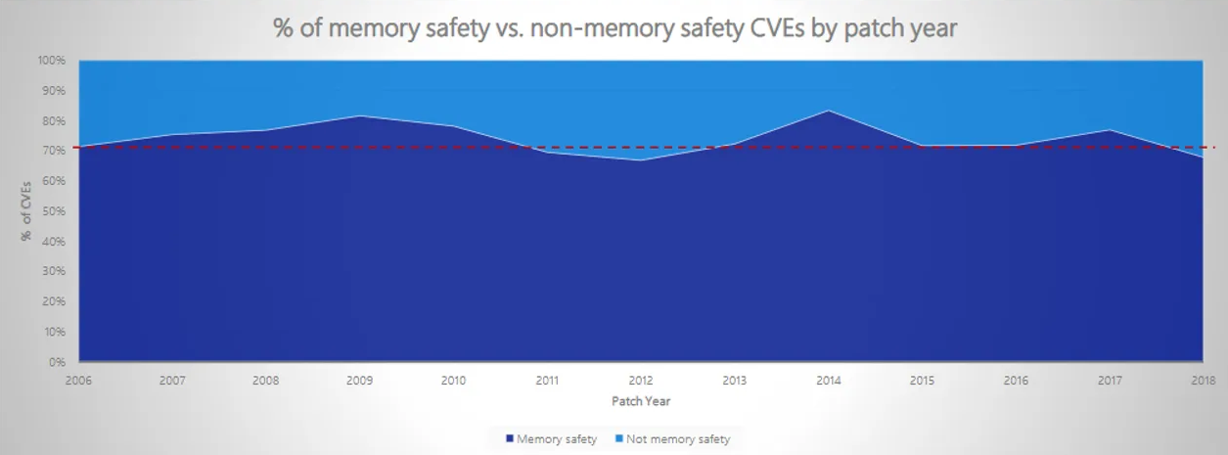
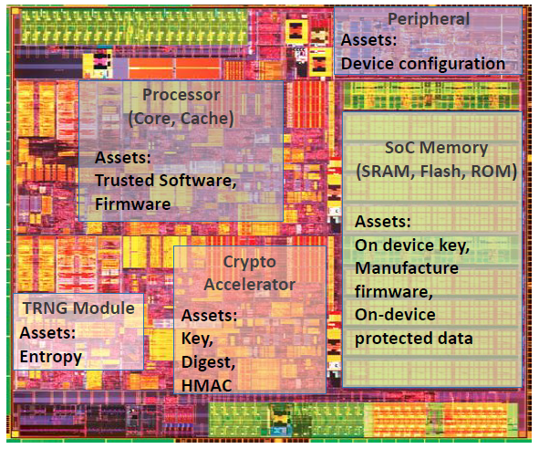
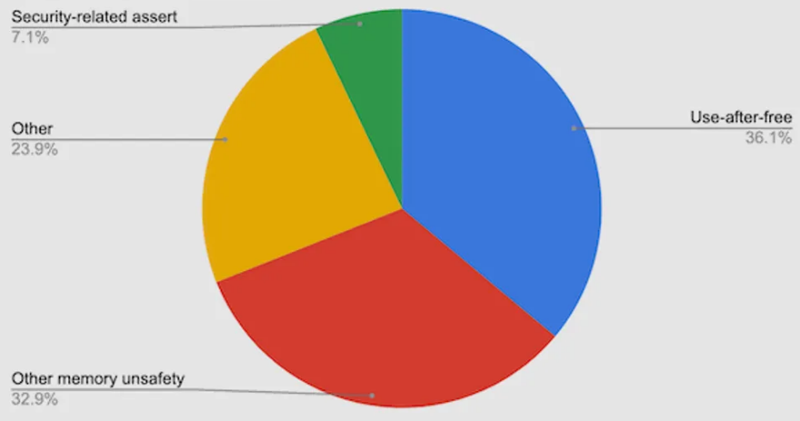



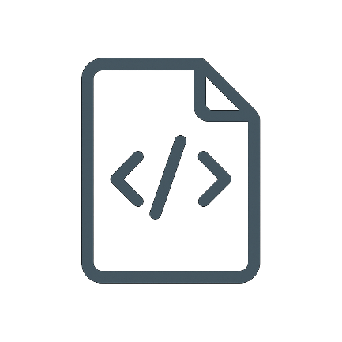








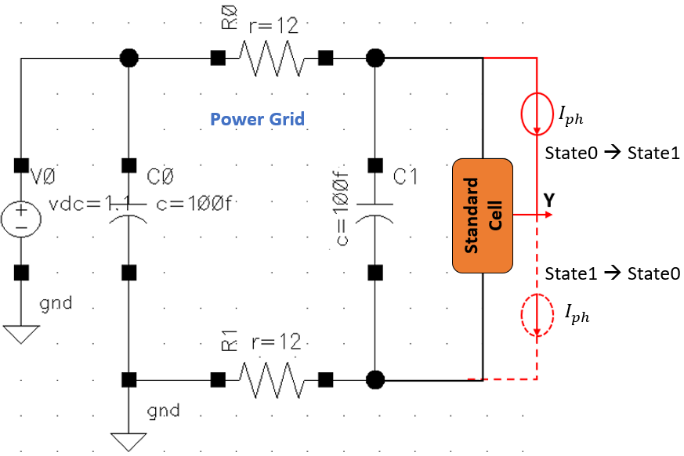
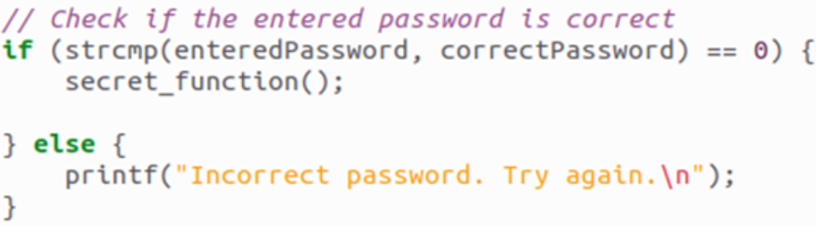
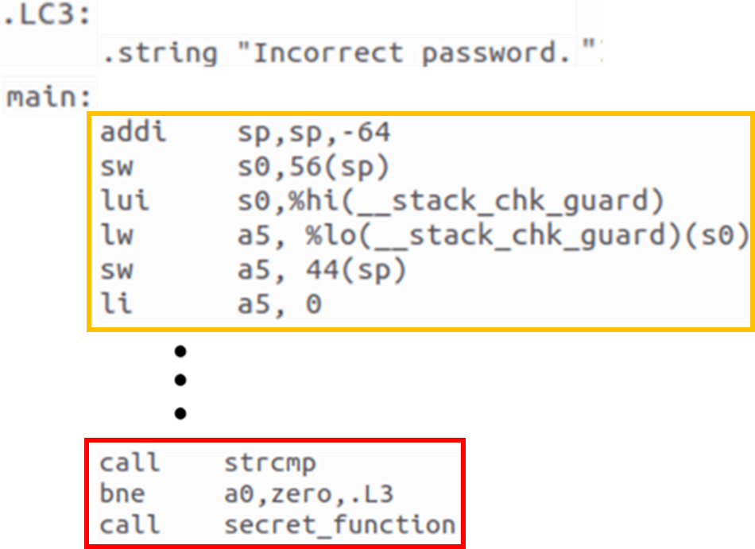
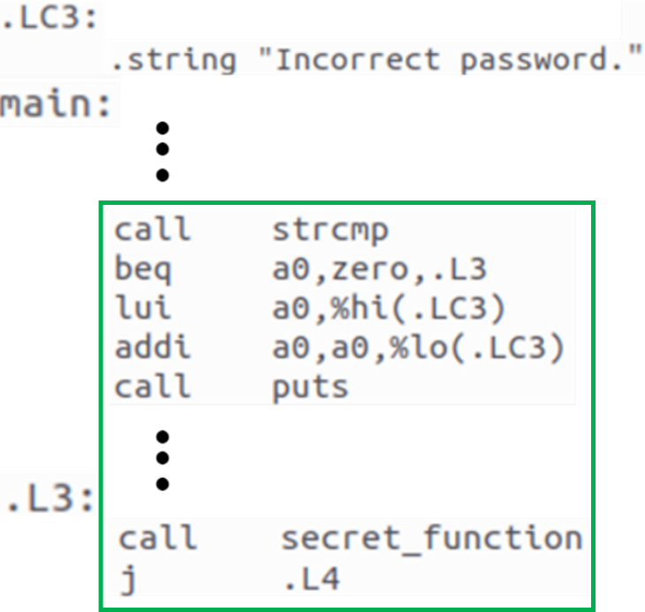
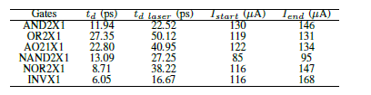

PASS : Physically-Aware Secure Software Execution
Arunabho Basu, Mridha Md Mashahedur Rahman, Pantha Pratim Sarker, Rakibul Hassan, Farimah Farahmandi, Mark M. Tehranipoor
University of Florida, Gainesville, Florida
Motivation
Problem Statement
Is my software aware that it’s running on vulnerable hardware?
Can it mitigate or patch underlying hardware vulnerabilities to ensure more secure execution?
Need to protect security assets from Physical Attacks
Most components of modern SoCs store some security asset like On-device keys, Manufacturer firmware, etc.
Software running on vulnerable hardware is not secure
Software execution is susceptible to both software and hardware attacks
Physical attack targets the physical logic implementations, bypassing upper-level security measures
Software developers/compilers are not informed of physical attacks (like Fault Injection Attacks)
The only existing physical modeling in compilers is based on unrealistic software-based predictions
Background
Existing efforts in Compiler Hardening against Vulnerabilities
C/C++ codes are susceptible to memory safety and control flow violations
Hardening at compilation enhance security and stability of compiled code
Compilers can harden code when security flags are enabled
Existing hardening techniques address software level vulnerabilities
They fail to address physical attack vulnerabilities because much of physical attributes are abstracted at software level
Microsoft says around 70% of security updates address memory safety vulnerabilities in their products
Source : Microsoft
The various security assets in a modern Intel SoC that needs to be protected.
Source: Intel
Google says up to 70% of addressable security issues in Google Chrome are related to memory safety.
Source : Google
Proposed Solution
Layout
RTL
Security Properties
Code Input
Objectives
Effective Modeling of Physical Vulnerabilities to make the compiler Physically-Aware
To implement and demonstrate Physical Hardening during compilation against Physical Attacks
Highlights of our proposed workflow
Fast and Powerful : Addressing physical threats during code compilation is fast and powerful because compiler links the hardware and software
Scalable and Cost effective : When physical vulnerabilities are discovered post-silicon stage, their hardening can be added to our framework, saving expensive chip callbacks
Secure Coding : Our physical models also inform software developers about underlying vulnerabilities in hardware
FIA
SCA
Fabricated Chip
Physical Attack Modeling
Compiler
Vulnerability Analysis
Code Hardening Rules
Hardened Code
Workflow for Hardening Software against Physical Attacks during compilation
Results
Summary
Key Takeaways :
Fig (a) shows that the physical impact of laser can be modeled as extra current sources in SPICE simulations.
Table (a) concludes that some standard cells are more vulnerable to laser fault injection than others
Fig (b) shows that rewriting conditional branches can harden it against fault injection attacks that aim to modify or bypass a conditional check instruction
We proposed a novel hardening flow that allows to address Fault Injection Vulnerabilities at the software compilation stage
Our approach models Fault-Injection Attacks based on physical design characteristics, facilitating secure software compilations with low-cost and effective physically-aware hardening techniques
We demonstrated that a critical conditional branch in a password-checking application could be protected against laser fault-injection attacks by reorganizing the assembly instructions during the compilation stage
Fig (a) : SPICE model simulating Standard Cell under Laser Fault Injection Attack
Source code in C
Future Work
For a simple password checking program, the standard cells involved in a conditional branch check are simulated under Laser Fault Injection using the SPICE model from Fig (a). In table (a), we present two physical characteristics of the standard cells :
The delay observed at output for high to low transition with and without laser fault injection,
The laser induced current before and after signal distortion
Compile with GCC-RISCV
Improve the precision of our current modeling of Laser Fault Injection
Model other categories of physical attacks such as clock/voltage glitching and side-channel attacks
Extend the hardening database for this physically-aware compiler
Harden
Acknowledgments
Assembly code compiled with built-in security flags
Hardened code from our proposed flow
This project has been made possible by the funding provided by SRC (GRC #3315) and the resources and facilities provided by Florida Institute of Cyber Security. We also want to share our deepest gratitude for Dr Mark Tehranipoor and Dr Farimah Farahmandi for their invaluable advice and Dr Rakibul Hassan for his continuous guidance and support every step of the way.
Impact of hardening :
Faults modifying/bypassing the conditional jump will now directly lead to a password-checking failure
Table (a) : Output delay variations and laser current values
when signal distortions start and end
Fig (b) : Example of Branch Hardening during Compilation

